Slide 1
Bootstrap Form
廖向德

Slide 2
Form Layouts
Bootstrap provides three types of form layouts:
Vertical form (default)
Horizontal form
Inline form
Standard rules for all three form layouts:
Wrap labels and form controls in <div class="form-group"> (needed for optimum spacing)
Add class .form-control to all textual <input>, <textarea>, and <select> elements

Slide 3
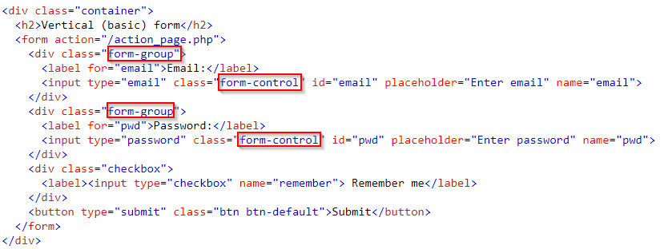
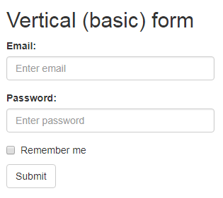
Vertical Form (default)
https://www.w3schools.com/bootstrap/tryit.asp?filename=trybs_form_basic&stacked=h
Notes:
<!DOCTYPE html>
<html lang="en">
<head>
<title>Bootstrap Example</title>
<meta charset="utf-8">
<meta name="viewport" content="width=device-width, initial-scale=1">
<link rel="stylesheet" href="https://maxcdn.bootstrapcdn.com/bootstrap/3.3.7/css/bootstrap.min.css">
<script src="https://ajax.googleapis.com/ajax/libs/jquery/3.2.1/jquery.min.js"></script>
<script src="https://maxcdn.bootstrapcdn.com/bootstrap/3.3.7/js/bootstrap.min.js"></script>
</head>
<body>
<div class="container">
<h2>Vertical (basic) form</h2>
<form action="/action_page.php">
<div class="form-group">
<label for="email">Email:</label>
<input type="email" class="form-control" id="email" placeholder="Enter email" name="email">
</div>
<div class="form-group">
<label for="pwd">Password:</label>
<input type="password" class="form-control" id="pwd" placeholder="Enter password" name="pwd">
</div>
<div class="checkbox">
<label><input type="checkbox" name="remember"> Remember me</label>
</div>
<button type="submit" class="btn btn-default">Submit</button>
</form>
</div>
</body>
</html>

Slide 4
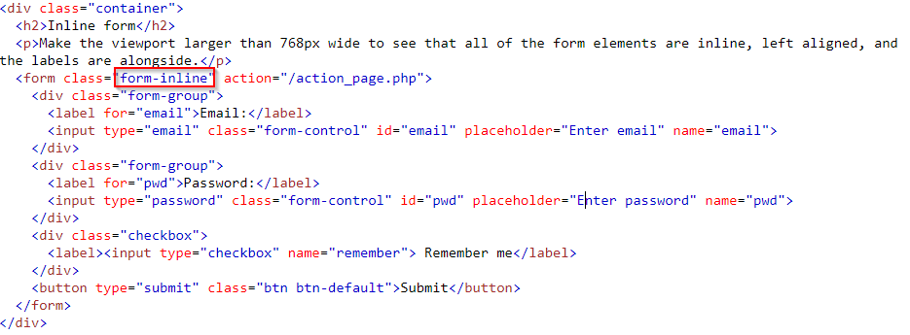
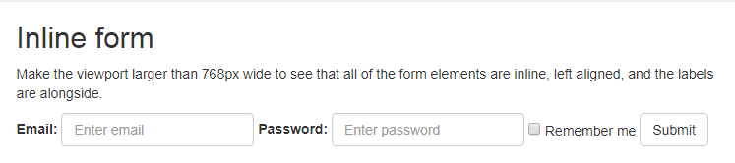
Inline Form
Note: This only applies to forms within viewports that are at least 768px wide!
https://www.w3schools.com/bootstrap/tryit.asp?filename=trybs_form_inline&stacked=h
Notes:
<!DOCTYPE html>
<html lang="en">
<head>
<title>Bootstrap Example</title>
<meta charset="utf-8">
<meta name="viewport" content="width=device-width, initial-scale=1">
<link rel="stylesheet" href="https://maxcdn.bootstrapcdn.com/bootstrap/3.3.7/css/bootstrap.min.css">
<script src="https://ajax.googleapis.com/ajax/libs/jquery/3.2.1/jquery.min.js"></script>
<script src="https://maxcdn.bootstrapcdn.com/bootstrap/3.3.7/js/bootstrap.min.js"></script>
</head>
<body>
<div class="container">
<h2>Inline form</h2>
<p>Make the viewport larger than 768px wide to see that all of the form elements are inline, left aligned, and the labels are alongside.</p>
<form class="form-inline" action="/action_page.php">
<div class="form-group">
<label for="email">Email:</label>
<input type="email" class="form-control" id="email" placeholder="Enter email" name="email">
</div>
<div class="form-group">
<label for="pwd">Password:</label>
<input type="password" class="form-control" id="pwd" placeholder="Enter password" name="pwd">
</div>
<div class="checkbox">
<label><input type="checkbox" name="remember"> Remember me</label>
</div>
<button type="submit" class="btn btn-default">Submit</button>
</form>
</div>
</body>
</html>ㄇ

Slide 5
Horizontal Form(1/3)
A horizontal form means that the labels are aligned next to the input field (horizontal) on large and medium screens
On small screens (767px and below), it will transform to a vertical form (labels are placed on top of each input).
Additional rules for a horizontal form:
Add class .form-horizontal to the <form> element
Add class .control-label to all <label> elements
Tip: Use Bootstrap's predefined grid classes to align labels and groups of form controls in a horizontal layout.

Slide 6
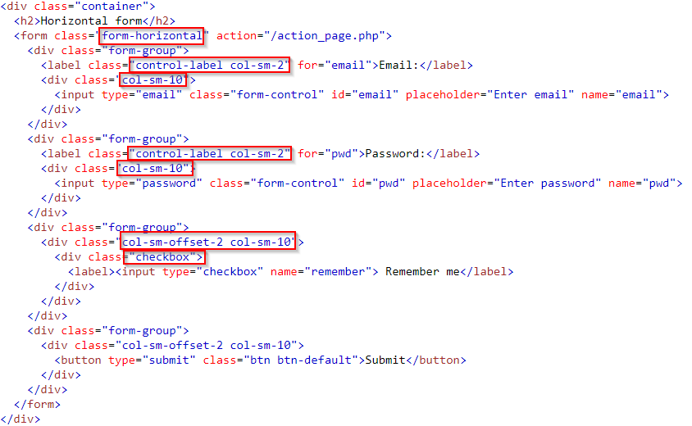
Horizontal Form(2/3)
Notes:
<!DOCTYPE html>
<html lang="en">
<head>
<title>Bootstrap Example</title>
<meta charset="utf-8">
<meta name="viewport" content="width=device-width, initial-scale=1">
<link rel="stylesheet" href="https://maxcdn.bootstrapcdn.com/bootstrap/3.3.7/css/bootstrap.min.css">
<script src="https://ajax.googleapis.com/ajax/libs/jquery/3.2.1/jquery.min.js"></script>
<script src="https://maxcdn.bootstrapcdn.com/bootstrap/3.3.7/js/bootstrap.min.js"></script>
</head>
<body>
<div class="container">
<h2>Horizontal form</h2>
<form class="form-horizontal" action="/action_page.php">
<div class="form-group">
<label class="control-label col-sm-2" for="email">Email:</label>
<div class="col-sm-10">
<input type="email" class="form-control" id="email" placeholder="Enter email" name="email">
</div>
</div>
<div class="form-group">
<label class="control-label col-sm-2" for="pwd">Password:</label>
<div class="col-sm-10">
<input type="password" class="form-control" id="pwd" placeholder="Enter password" name="pwd">
</div>
</div>
<div class="form-group">
<div class="col-sm-offset-2 col-sm-10">
<div class="checkbox">
<label><input type="checkbox" name="remember"> Remember me</label>
</div>
</div>
</div>
<div class="form-group">
<div class="col-sm-offset-2 col-sm-10">
<button type="submit" class="btn btn-default">Submit</button>
</div>
</div>
</form>
</div>
</body>
</html>

Slide 7
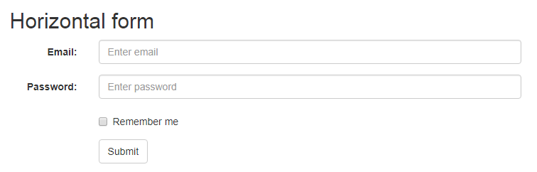
Horizontal Form(3/3)
https://www.w3schools.com/bootstrap/tryit.asp?filename=trybs_form_horizontal&stacked=h

Slide 8
Form Inputs
Bootstrap supports the following form controls:
Input, textarea, checkbox, radio, select

Slide 9
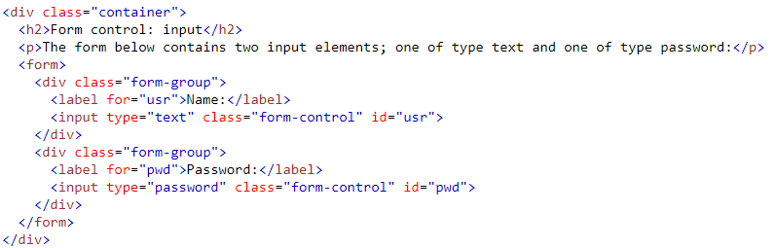
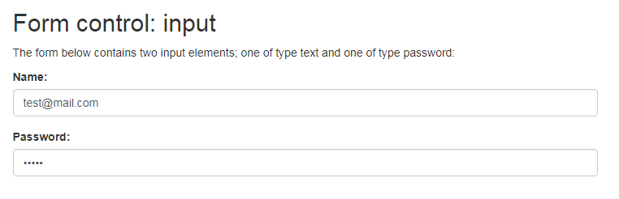
Input
Bootstrap supports all the HTML5 input types: text, password, datetime, datetime-local, date, month, time, week, number, email, url, search, tel, and color

Slide 10
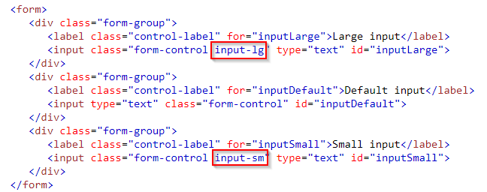
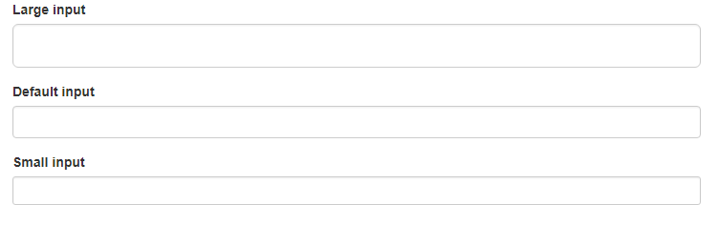
Change Inputs Size
Notes:
<!DOCTYPE html>
<html lang="en">
<head>
<title>Bootstrap Example</title>
<meta charset="utf-8">
<meta name="viewport" content="width=device-width, initial-scale=1">
<link rel="stylesheet" href="https://maxcdn.bootstrapcdn.com/bootstrap/3.3.7/css/bootstrap.min.css">
<script src="https://ajax.googleapis.com/ajax/libs/jquery/3.2.1/jquery.min.js"></script>
<script src="https://maxcdn.bootstrapcdn.com/bootstrap/3.3.7/js/bootstrap.min.js"></script>
</head>
<body>
<div class="container">
<form>
<div class="form-group">
<label class="control-label" for="inputLarge">Large input</label>
<input class="form-control input-lg" type="text" id="inputLarge">
</div>
<div class="form-group">
<label class="control-label" for="inputDefault">Default input</label>
<input type="text" class="form-control" id="inputDefault">
</div>
<div class="form-group">
<label class="control-label" for="inputSmall">Small input</label>
<input class="form-control input-sm" type="text" id="inputSmall">
</div>
</form>
</div>
</body>
</html>

Slide 11
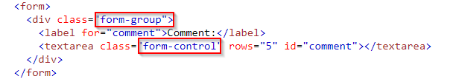
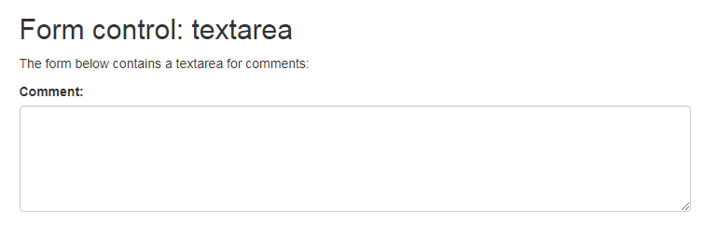
Textarea

Slide 12
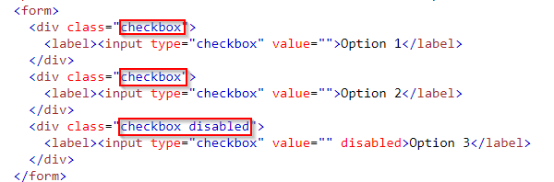
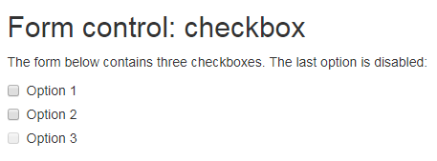
Checkboxes
https://www.w3schools.com/bootstrap/tryit.asp?filename=trybs_form_checkbox&stacked=h

Slide 13

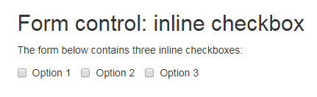
Inline Checkboxes
Use the .checkbox-inline class if you want the checkboxes to appear on the same line
https://www.w3schools.com/bootstrap/tryit.asp?filename=trybs_form_checkbox_inline&stacked=h
Notes:
<!DOCTYPE html>
<html lang="en">
<head>
<title>Bootstrap Example</title>
<meta charset="utf-8">
<meta name="viewport" content="width=device-width, initial-scale=1">
<link rel="stylesheet" href="https://maxcdn.bootstrapcdn.com/bootstrap/3.3.7/css/bootstrap.min.css">
<script src="https://ajax.googleapis.com/ajax/libs/jquery/3.2.1/jquery.min.js"></script>
<script src="https://maxcdn.bootstrapcdn.com/bootstrap/3.3.7/js/bootstrap.min.js"></script>
</head>
<body>
<div class="container">
<h2>Form control: inline checkbox</h2>
<p>The form below contains three inline checkboxes:</p>
<form>
<label class="checkbox-inline">
<input type="checkbox" value="">Option 1
</label>
<label class="checkbox-inline">
<input type="checkbox" value="">Option 2
</label>
<label class="checkbox-inline">
<input type="checkbox" value="">Option 3
</label>
</form>
</div>
</body>
</html>

Slide 14
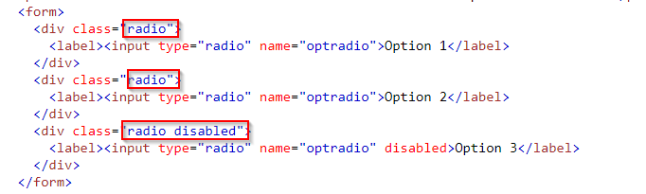
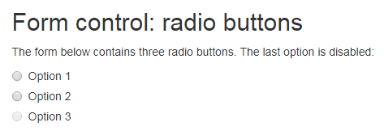
Radio Buttons
https://www.w3schools.com/bootstrap/tryit.asp?filename=trybs_form_radio&stacked=h
Notes:
<!DOCTYPE html>
<html lang="en">
<head>
<title>Bootstrap Example</title>
<meta charset="utf-8">
<meta name="viewport" content="width=device-width, initial-scale=1">
<link rel="stylesheet" href="https://maxcdn.bootstrapcdn.com/bootstrap/3.3.7/css/bootstrap.min.css">
<script src="https://ajax.googleapis.com/ajax/libs/jquery/3.2.1/jquery.min.js"></script>
<script src="https://maxcdn.bootstrapcdn.com/bootstrap/3.3.7/js/bootstrap.min.js"></script>
</head>
<body>
<div class="container">
<h2>Form control: radio buttons</h2>
<p>The form below contains three radio buttons. The last option is disabled:</p>
<form>
<div class="radio">
<label><input type="radio" name="optradio">Option 1</label>
</div>
<div class="radio">
<label><input type="radio" name="optradio">Option 2</label>
</div>
<div class="radio disabled">
<label><input type="radio" name="optradio" disabled>Option 3</label>
</div>
</form>
</div>
</body>
</html>

Slide 15

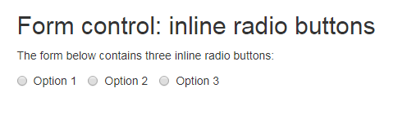
Inline Radio Buttons
https://www.w3schools.com/bootstrap/tryit.asp?filename=trybs_form_radio_inline&stacked=h
Notes:
<!DOCTYPE html>
<html lang="en">
<head>
<title>Bootstrap Example</title>
<meta charset="utf-8">
<meta name="viewport" content="width=device-width, initial-scale=1">
<link rel="stylesheet" href="https://maxcdn.bootstrapcdn.com/bootstrap/3.3.7/css/bootstrap.min.css">
<script src="https://ajax.googleapis.com/ajax/libs/jquery/3.2.1/jquery.min.js"></script>
<script src="https://maxcdn.bootstrapcdn.com/bootstrap/3.3.7/js/bootstrap.min.js"></script>
</head>
<body>
<div class="container">
<h2>Form control: inline radio buttons</h2>
<p>The form below contains three inline radio buttons:</p>
<form>
<label class="radio-inline">
<input type="radio" name="optradio">Option 1
</label>
<label class="radio-inline">
<input type="radio" name="optradio">Option 2
</label>
<label class="radio-inline">
<input type="radio" name="optradio">Option 3
</label>
</form>
</div>
</body>
</html>

Slide 16
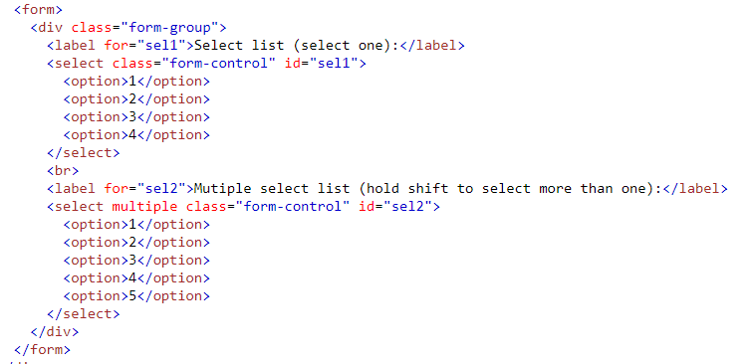
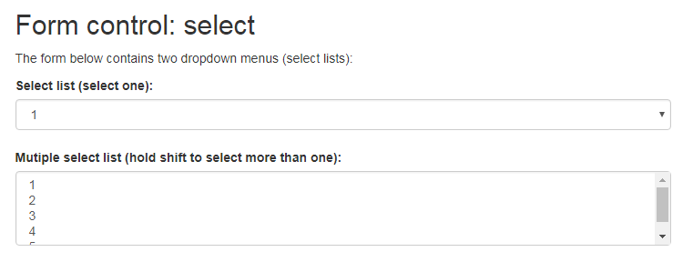
Select List
https://www.w3schools.com/bootstrap/tryit.asp?filename=trybs_form_select&stacked=h
Notes:
<!DOCTYPE html>
<html lang="en">
<head>
<title>Bootstrap Example</title>
<meta charset="utf-8">
<meta name="viewport" content="width=device-width, initial-scale=1">
<link rel="stylesheet" href="https://maxcdn.bootstrapcdn.com/bootstrap/3.3.7/css/bootstrap.min.css">
<script src="https://ajax.googleapis.com/ajax/libs/jquery/3.2.1/jquery.min.js"></script>
<script src="https://maxcdn.bootstrapcdn.com/bootstrap/3.3.7/js/bootstrap.min.js"></script>
</head>
<body>
<div class="container">
<h2>Form control: select</h2>
<p>The form below contains two dropdown menus (select lists):</p>
<form>
<div class="form-group">
<label for="sel1">Select list (select one):</label>
<select class="form-control" id="sel1">
<option>1</option>
<option>2</option>
<option>3</option>
<option>4</option>
</select>
<br>
<label for="sel2">Mutiple select list (hold shift to select more than one):</label>
<select multiple class="form-control" id="sel2">
<option>1</option>
<option>2</option>
<option>3</option>
<option>4</option>
<option>5</option>
</select>
</div>
</form>
</div>
</body>
</html>

Slide 17
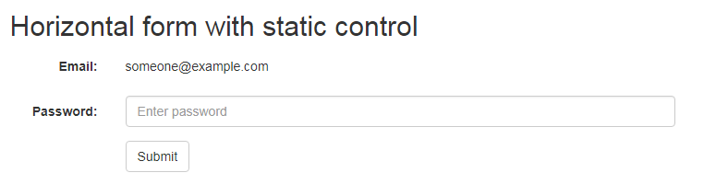
Static Control (1/2)
If you need to insert plain text next to a form label within a horizontal form, use the .form-control-static class on a <p> element
https://www.w3schools.com/bootstrap/tryit.asp?filename=trybs_form_horizontal_static&stacked=h
Notes:
<!DOCTYPE html>
<html lang="en">
<head>
<title>Bootstrap Example</title>
<meta charset="utf-8">
<meta name="viewport" content="width=device-width, initial-scale=1">
<link rel="stylesheet" href="https://maxcdn.bootstrapcdn.com/bootstrap/3.3.7/css/bootstrap.min.css">
<script src="https://ajax.googleapis.com/ajax/libs/jquery/3.2.1/jquery.min.js"></script>
<script src="https://maxcdn.bootstrapcdn.com/bootstrap/3.3.7/js/bootstrap.min.js"></script>
</head>
<body>
<div class="container">
<h2>Horizontal form with static control</h2>
<form class="form-horizontal" action="/action_page.php">
<div class="form-group">
<label class="control-label col-sm-2" for="email">Email:</label>
<div class="col-sm-10">
<p class="form-control-static">someone@example.com</p>
</div>
</div>
<div class="form-group">
<label class="control-label col-sm-2" for="pwd">Password:</label>
<div class="col-sm-10">
<input type="password" class="form-control" id="pwd" placeholder="Enter password" name="pwd">
</div>
</div>
<div class="form-group">
<div class="col-sm-offset-2 col-sm-10">
<button type="submit" class="btn btn-default">Submit</button>
</div>
</div>
</form>
</div>
</body>
</html>

Slide 18
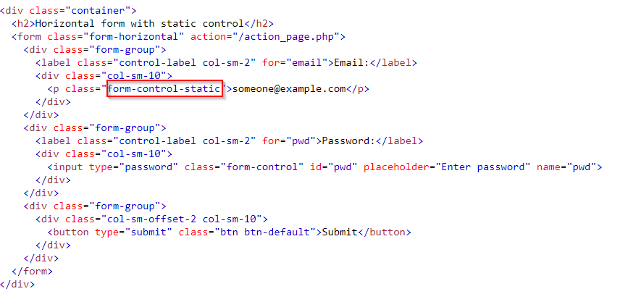
Static Control (2/2)
Notes:
<!DOCTYPE html>
<html lang="en">
<head>
<title>Bootstrap Example</title>
<meta charset="utf-8">
<meta name="viewport" content="width=device-width, initial-scale=1">
<link rel="stylesheet" href="https://maxcdn.bootstrapcdn.com/bootstrap/3.3.7/css/bootstrap.min.css">
<script src="https://ajax.googleapis.com/ajax/libs/jquery/3.2.1/jquery.min.js"></script>
<script src="https://maxcdn.bootstrapcdn.com/bootstrap/3.3.7/js/bootstrap.min.js"></script>
</head>
<body>
<div class="container">
<h2>Horizontal form with static control</h2>
<form class="form-horizontal" action="/action_page.php">
<div class="form-group">
<label class="control-label col-sm-2" for="email">Email:</label>
<div class="col-sm-10">
<p class="form-control-static">someone@example.com</p>
</div>
</div>
<div class="form-group">
<label class="control-label col-sm-2" for="pwd">Password:</label>
<div class="col-sm-10">
<input type="password" class="form-control" id="pwd" placeholder="Enter password" name="pwd">
</div>
</div>
<div class="form-group">
<div class="col-sm-offset-2 col-sm-10">
<button type="submit" class="btn btn-default">Submit</button>
</div>
</div>
</form>
</div>
</body>
</html>

Slide 19
Form Control States
DISABLED INPUTS - Add a disabled attribute to disable an input field
DISABLED FIELDSETS - Add a disabled attribute to a fieldset to disable all controls within
READONLY INPUTS - Add a readonly attribute to an input to prevent user input
VALIDATION STATES - Bootstrap includes validation styles for error, warning, and success messages. To use, add .has-warning, .has-error, or .has-success to the parent element
ICONS - You can add feedback icons with the .has-feedback class and an icon
HIDDEN LABELS - Add a .sr-only class on non-visible labels

Slide 20
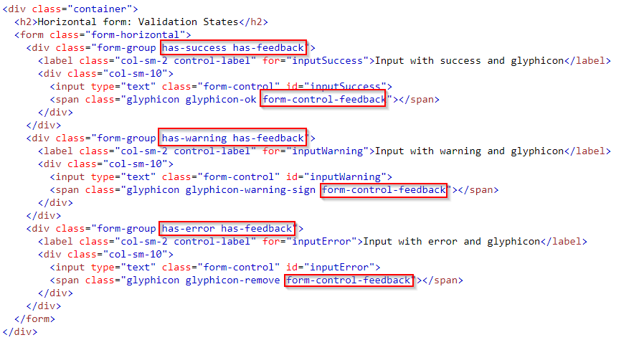
Validation States (1/2)
Notes:
<!DOCTYPE html>
<html lang="en">
<head>
<title>Bootstrap Example</title>
<meta charset="utf-8">
<meta name="viewport" content="width=device-width, initial-scale=1">
<link rel="stylesheet" href="https://maxcdn.bootstrapcdn.com/bootstrap/3.3.7/css/bootstrap.min.css">
<script src="https://ajax.googleapis.com/ajax/libs/jquery/3.2.1/jquery.min.js"></script>
<script src="https://maxcdn.bootstrapcdn.com/bootstrap/3.3.7/js/bootstrap.min.js"></script>
</head>
<body>
<div class="container">
<h2>Horizontal form: Validation States</h2>
<form class="form-horizontal">
<div class="form-group has-success has-feedback">
<label class="col-sm-2 control-label" for="inputSuccess">Input with success and glyphicon</label>
<div class="col-sm-10">
<input type="text" class="form-control" id="inputSuccess">
<span class="glyphicon glyphicon-ok form-control-feedback"></span>
</div>
</div>
<div class="form-group has-warning has-feedback">
<label class="col-sm-2 control-label" for="inputWarning">Input with warning and glyphicon</label>
<div class="col-sm-10">
<input type="text" class="form-control" id="inputWarning">
<span class="glyphicon glyphicon-warning-sign form-control-feedback"></span>
</div>
</div>
<div class="form-group has-error has-feedback">
<label class="col-sm-2 control-label" for="inputError">Input with error and glyphicon</label>
<div class="col-sm-10">
<input type="text" class="form-control" id="inputError">
<span class="glyphicon glyphicon-remove form-control-feedback"></span>
</div>
</div>
</form>
</div>
</body>
</html>

Slide 21
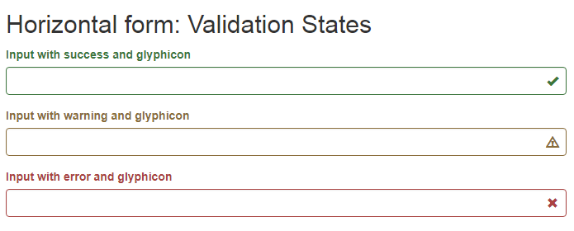
Validation States (2/2)
https://www.w3schools.com/code/tryit.asp?filename=FKDI210GIV2Z
Notes:
<!DOCTYPE html>
<html lang="en">
<head>
<title>Bootstrap Example</title>
<meta charset="utf-8">
<meta name="viewport" content="width=device-width, initial-scale=1">
<link rel="stylesheet" href="https://maxcdn.bootstrapcdn.com/bootstrap/3.3.7/css/bootstrap.min.css">
<script src="https://ajax.googleapis.com/ajax/libs/jquery/3.2.1/jquery.min.js"></script>
<script src="https://maxcdn.bootstrapcdn.com/bootstrap/3.3.7/js/bootstrap.min.js"></script>
</head>
<body>
<div class="container">
<h2>Horizontal form: Validation States</h2>
<form class="form-horizontal">
<div class="form-group has-success has-feedback">
<label class="col-sm-2 control-label" for="inputSuccess">Input with success and glyphicon</label>
<div class="col-sm-10">
<input type="text" class="form-control" id="inputSuccess">
<span class="glyphicon glyphicon-ok form-control-feedback"></span>
</div>
</div>
<div class="form-group has-warning has-feedback">
<label class="col-sm-2 control-label" for="inputWarning">Input with warning and glyphicon</label>
<div class="col-sm-10">
<input type="text" class="form-control" id="inputWarning">
<span class="glyphicon glyphicon-warning-sign form-control-feedback"></span>
</div>
</div>
<div class="form-group has-error has-feedback">
<label class="col-sm-2 control-label" for="inputError">Input with error and glyphicon</label>
<div class="col-sm-10">
<input type="text" class="form-control" id="inputError">
<span class="glyphicon glyphicon-remove form-control-feedback"></span>
</div>
</div>
</form>
</div>
</body>
</html>

Slide 22
Input Groups

Slide 23
Creating Prepended and Appended Inputs(1/2)
Wrap the text or icon within a <span> element having the class .input-group-addon and place it before or after the <input> element.
Wrap both the <span> and text-based <input> element within a <div> element and apply the class .input-group on it.
Note:Bootstrap's prepending or appending feature is only available to text-based inputs. It does not support <select> or <textarea> elements.
https://www.w3schools.com/code/tryit.asp?filename=FKDEEEY65OQT

Slide 24
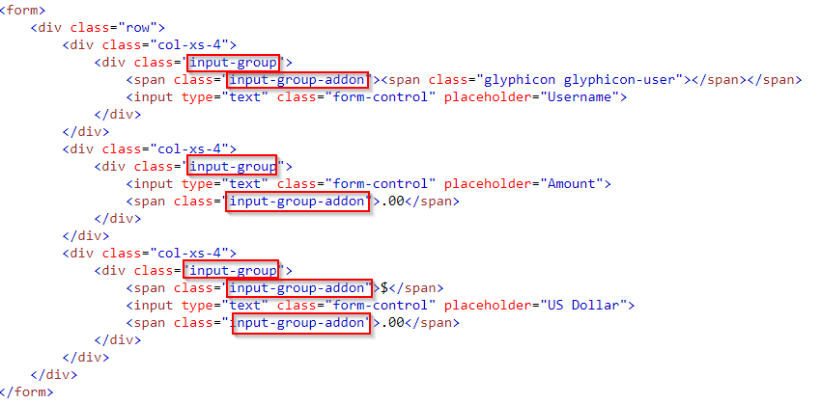

Creating Prepended and Appended Inputs(2/2)
Notes:
<!DOCTYPE html>
<html lang="en">
<head>
<title>Bootstrap Example</title>
<meta charset="utf-8">
<meta name="viewport" content="width=device-width, initial-scale=1">
<link rel="stylesheet" href="https://maxcdn.bootstrapcdn.com/bootstrap/3.3.7/css/bootstrap.min.css">
<script src="https://ajax.googleapis.com/ajax/libs/jquery/3.2.1/jquery.min.js"></script>
<script src="https://maxcdn.bootstrapcdn.com/bootstrap/3.3.7/js/bootstrap.min.js"></script>
</head>
<body>
<div class="container">
<h2>Prepend or append text and icons to an input:</h2>
<form>
<div class="row">
<div class="col-xs-4">
<div class="input-group">
<span class="input-group-addon"><span class="glyphicon glyphicon-user"></span></span>
<input type="text" class="form-control" placeholder="Username">
</div>
</div>
<div class="col-xs-4">
<div class="input-group">
<input type="text" class="form-control" placeholder="Amount">
<span class="input-group-addon">.00</span>
</div>
</div>
<div class="col-xs-4">
<div class="input-group">
<span class="input-group-addon">$</span>
<input type="text" class="form-control" placeholder="US Dollar">
<span class="input-group-addon">.00</span>
</div>
</div>
</div>
</form>
</div>
</body>
</html>

Slide 25
Checkboxes and Radio Buttons Addons

Slide 26
Buttons Addons for Text Inputs

Slide 27
Adding Button Dropdowns to Text Inputs

Slide 28
Adding Segmented Dropdown Button Groups

